Slide 1
Creating Procedures
Lesson 10
10-<number>

Slide 2

Objectives
  Identify the benefits of modularized and layered subprogram design
  Create and call procedures
  Use formal and actual parameters
  Use positional, named, or mixed notation for passing parameters
  Identify the available parameter-passing modes
  Handle exceptions in procedures
  Remove a procedure
  Display the procedures’ information
8
7
6
5
4
3
2
1
10-<number>
Notes:
Oracle Database: Develop PL/SQL Program Units 1 - <number>
Lesson Aim
In this lesson, you learn to create, execute, and remove procedures with or without parameters. Procedures are the foundation of modular programming in PL/SQL. To make procedures more flexible, it is important that varying data is either calculated or passed into a procedure by using input parameters. Calculated results can be returned to the caller of a procedure by using OUT parameters.
To make your programs robust, you should always manage exception conditions by using the exception-handling features of PL/SQL.

Slide 3

Session Plan
Using a modularized and layered subprogram design and identifying the benefits of subprograms
Subprogram Design
    Creating and calling procedures
    Identifying the available parameter-passing modes
    Using formal and actual parameters
    Using positional, named, or mixed notation
Procedures
Exception Handling
Handling exceptions in procedures, removing a procedure, and displaying the procedures’ information
10-<number>
Notes:
Oracle Database: Develop PL/SQL Program Units 1 - <number>

Slide 4
Creating a Modularized Subprogram Design
Modularize code into subprograms.
  Locate code sequences repeated more that once.
  Create subprogram P containing the repeated code
  Modify original code to invoke the new subprogram.
1
3
xx xxx xxx
xx xxx xxx
----- --- ---
----- --- ---
xx xxx xxx
xx xxx xxx
----- --- ---
2
P
----- --- ---
----- --- ---
P
----- --- ---
xx xxx xxx
xx xxx xxx
P
10-<number>
Notes:
Oracle Database: Develop PL/SQL Program Units 1 - <number>
Creating a Modularized and Layered Subprogram Design
The diagram illustrates the principle of modularization with subprograms: the creation of smaller manageable pieces of flexible and reusable code. Flexibility is achieved by using subprograms with parameters, which in turn makes the same code reusable for different input values. To modularize existing code, perform the following steps:
1. Locate and identify repetitive sequences of code.
2. Move the repetitive code into a PL/SQL subprogram.
3. Replace the original repetitive code with calls to the new PL/SQL subprogram.
Following this modular and layered approach can help you create code that is easier to maintain, particularly when the business rules change. In addition, keeping the SQL logic simple and free of complex business logic can benefit from the work of Oracle Database Optimizer, which can reuse parsed SQL statements for better use of server-side resources.

Slide 5
Creating a Layered Subprogram Design
Create subprogram layers for your application.
  Data access subprogram layer with SQL logic
  Business logic subprogram layer, which may or may not use the data access layer
10-<number>
Notes:
Oracle Database: Develop PL/SQL Program Units 1 - <number>
Creating a Layered Subprogram Design
Because PL/SQL allows SQL statements to be seamlessly embedded into the logic, it is too easy to have SQL statement spread all over the code. However, it is recommended that you keep the SQL logic separate from the business logic—that is, create a layered application design with a minimum of two layers:
Data access layer: For subroutines to access the data by using SQL statements
Business logic layer: For subprograms to implement the business processing rules, which may or may not call on the data access layer routines

Slide 6
Modularizing Development with PL/SQL Blocks
  PL/SQL is a block-structured language. The PL/SQL code block helps modularize code by using:
    Anonymous blocks
    Procedures and functions
    Packages
    Database triggers
  The benefits of using modular program constructs are:
    Easy maintenance
    Improved data security and integrity
    Improved performance
    Improved code clarity
10-<number>
Notes:
Oracle Database: Develop PL/SQL Program Units 1 - <number>
Modularizing Development with PL/SQL Blocks
A subprogram is based on standard PL/SQL structures. It contains a declarative section, an executable section, and an optional exception-handling section (for example, anonymous blocks, procedures, functions, packages, and triggers). Subprograms can be compiled and stored in the database, providing modularity, extensibility, reusability, and maintainability.
Modularization converts large blocks of code into smaller groups of code called modules. After modularization, the modules can be reused by the same program or shared with other programs. It is easier to maintain and debug code that comprises smaller modules than it is to maintain code in a single large program. Modules can be easily extended for customization by incorporating more functionality, if required, without affecting the remaining modules of the program.
Subprograms provide easy maintenance because the code is located in one place and any modifications required to the subprogram can, therefore, be performed in this single location. Subprograms provide improved data integrity and security. The data objects are accessed through the subprogram, and a user can invoke the subprogram only if the appropriate access privilege is granted to the user.
Note: Knowing how to develop anonymous blocks is a prerequisite for this course. For detailed information about anonymous blocks, see the course titled Oracle: PL/SQL Fundamentals.

Slide 7


What Are PL/SQL Subprograms?
  A PL/SQL subprogram is a named PL/SQL block that can be called with a set of parameters.
  You can declare and define a subprogram within either a PL/SQL block or another subprogram.
  A subprogram consists of a specification and a body.
  A subprogram can be a procedure or a function.
  Typically, you use a procedure to perform an action and a function to compute and return a value.
  Subprograms can be grouped into PL/SQL packages.
10-<number>
Notes:
Oracle Database: Develop PL/SQL Program Units 1 - <number>
What Are PL/SQL Subprograms?
A PL/SQL subprogram is a named PL/SQL block that can be called with a set of parameters. You can declare and define a subprogram within either a PL/SQL block or another subprogram.
Subprogram Parts
A subprogram consists of a specification (spec) and a body. To declare a subprogram, you must provide the spec, which includes descriptions of any parameters. To define a subprogram, you must provide both the spec and the body. You can either declare a subprogram first and define it later in the same block or subprogram, or declare and define it at the same time.
Subprogram Types
PL/SQL has two types of subprograms: procedures and functions. Typically, you use a procedure to perform an action and a function to compute and return a value.
A procedure and a function have the same structure, except that only a function has some additional items such as the RETURN clause or the RETURN statement.
The RETURN clause specifies the data type of the return value (required). A RETURN statement specifies the return value (required). Functions are covered in more detail in the next lesson titled “Creating Functions and Debugging Subprograms.”
Subprograms can be grouped into PL/SQL packages, which make code even more reusable and maintainable. Packages are covered in the packages lessons: Lessons 3 and 4.

Slide 8





The Benefits of Using PL/SQL Subprograms
Easy maintenance
Improved data security and integrity
Subprograms:
Stored procedures and functions
Improved code clarity
  Improved performance
10-<number>
Notes:
Oracle Database: Develop PL/SQL Program Units 1 - <number>
Benefits of Subprograms
Procedures and functions have many benefits due to modularizing of code:
Easy maintenance is realized because subprograms are located in one place. Modifications need to be done in only one place to affect multiple applications and minimize excessive testing.
Improved data security can be achieved by controlling indirect access to database objects from nonprivileged users with security privileges. The subprograms are by default executed with definer’s right. The execute privilege does not allow a calling user direct access to objects that are accessible to the subprogram.
Data integrity is managed by having related actions performed together or not at all.
Improved performance can be realized from reuse of parsed PL/SQL code that becomes available in the shared SQL area of the server. Subsequent calls to the subprogram avoid parsing the code again. Because PL/SQL code is parsed at compile time, the parsing overhead of SQL statements is avoided at run time. Code can be written to reduce the number of network calls to the database, and therefore, decrease network traffic.
Improved code clarity can be attained by using appropriate names and conventions to describe the action of the routines, thereby reducing the need for comments and enhancing the clarity of the code.

Slide 9
Differences Between Anonymous Blocks and Subprograms
Anonymous Blocks | Subprograms
Unnamed PL/SQL blocks | Named PL/SQL blocks
Compiled every time | Compiled only once
Not stored in the database | Stored in the database
Cannot be invoked by other applications | Named and, therefore, can be invoked by other applications
Do not return values | Subprograms called functions must return values.
Cannot take parameters | Can take parameters
10-<number>
Notes:
Oracle Database: Develop PL/SQL Program Units 1 - <number>
Differences Between Anonymous Blocks and Subprograms
The table in the slide not only shows the differences between anonymous blocks and subprograms, but also highlights the general benefits of subprograms.
Anonymous blocks are not persistent database objects. They are compiled and executed
only once. They are not stored in the database for reuse. If you want to reuse, you must rerun the script that creates the anonymous block, which causes recompilation and execution.
Procedures and functions are compiled and stored in the database in a compiled form.
They are recompiled only when they are modified. Because they are stored in the database, any application can make use of these subprograms based on appropriate permissions. The calling application can pass parameters to the procedures if the procedure is designed to accept parameters. Similarly, a calling application can retrieve a value if it invokes a function or a procedure.

Slide 10
Session Plan
Using a modularized and layered subprogram design and identifying the benefits of subprograms
Subprogram Design
    Creating and calling procedures
    Identifying the available parameter-passing modes
    Using formal and actual parameters
    Using positional, named, or mixed notation
Procedures
Exception Handling
Handling exceptions in procedures, removing a procedure, and displaying the procedures’ information
10-<number>
Notes:
Oracle Database: Develop PL/SQL Program Units 1 - <number>

Slide 11


What Are Procedures?
  Are a type of subprogram that perform an action
  Can be stored in the database as a schema object
  Promote reusability and maintainability
Procedures
10-<number>
Notes:
Oracle Database: Develop PL/SQL Program Units 1 - <number>
Definition of a Procedure
A procedure is a named PL/SQL block that can accept parameters (sometimes referred to as arguments). Generally, you use a procedure to perform an action. It has a header, a declaration section, an executable section, and an optional exception-handling section. A procedure is invoked by using the procedure name in the execution section of another PL/SQL block.
A procedure is compiled and stored in the database as a schema object. If you are using the procedures with Oracle Forms and Reports, then they can be compiled within the Oracle Forms or Oracle Reports executables.
Procedures promote reusability and maintainability. When validated, they can be used in any number of applications. If the requirements change, only the procedure needs to be updated.

Slide 12









Creating Procedures: Overview
View errors/warnings
in SQL Developer
YES
Use SHOW ERRORS
command in SQL*Plus
Create/edit procedure
Compiler
warnings/errors?
View compiler
warnings/errors
NO
Use USER/ALL/DBA_
ERRORS views
Execute procedure
10-<number>
Notes:
Oracle Database: Develop PL/SQL Program Units 1 - <number>
Creating Procedures: Overview
To develop a procedure using a tool such as SQL Developer, perform the following steps:
1. Create the procedure using SQL Developer’s Object Navigator tree or the SQL Worksheet area.
2. Compile the procedure. The procedure is created in the database and gets compiled. The CREATE PROCEDURE statement creates and stores the source code and the compiled m-code in the database. To compile the procedure, right-click the procedure’s name in the Object Navigator tree, and then click Compile.
3. If compilation errors exist, then the m-code is not stored and you must edit the source code to make corrections. You cannot invoke a procedure that contains compilation errors. You can view the compilation errors in SQL Developer, SQL*Plus, or the appropriate data dictionary views as shown in the slide.
4. After successful compilation, execute the procedure to perform the desired action. You can run the procedure using SQL Developer or use the EXECUTE command in SQL*Plus.
Note: If compilation errors occur, use a CREATE OR REPLACE PROCEDURE statement to overwrite the existing code if you previously used a CREATE PROCEDURE statement. Otherwise, drop the procedure first (using DROP) and then execute the CREATE PROCEDURE statement.

Slide 13
Creating Procedures with the SQL
CREATE OR REPLACE Statement
  Use the CREATE clause to create a stand-alone procedure that is stored in the Oracle database.
  Use the OR REPLACE option to overwrite an existing procedure.
CREATE [OR REPLACE] PROCEDURE procedure_name
[(parameter1 [mode] datatype1,
parameter2 [mode] datatype2, ...)]
IS|AS
[local_variable_declarations; ...]
BEGIN
-- actions;
END [procedure_name];
PL/SQL block
10-<number>
Notes:
Oracle Database: Develop PL/SQL Program Units 1 - <number>
Creating Procedures with the SQL CREATE OR REPLACE Statement
You can use the CREATE PROCEDURE SQL statement to create stand-alone procedures that are stored in an Oracle database. A procedure is similar to a miniature program: it performs a specific action. You specify the name of the procedure, its parameters, its local variables, and the BEGIN-END block that contains its code and handles any exceptions.
PL/SQL blocks start with BEGIN, optionally preceded by the declaration of local variables. PL/SQL blocks end with either END or END procedure_name.
The REPLACE option indicates that if the procedure exists, it is dropped and replaced with the new version created by the statement. The REPLACE option does not drop any of the privileges associated with the procedure.
Other Syntactic Elements
parameter1 represents the name of a parameter.
The mode option defines how a parameter is used: IN (default), OUT, or IN OUT.
datatype1 specifies the parameter data type, without any precision.
Note: Parameters can be considered as local variables. Substitution and host (bind) variables cannot be referenced anywhere in the definition of a PL/SQL stored procedure. The OR REPLACE option does not require any change in object security, as long as you own the object and have the CREATE [ANY] PROCEDURE privilege.

Slide 14
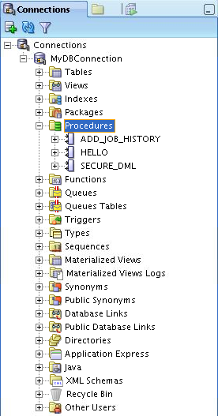
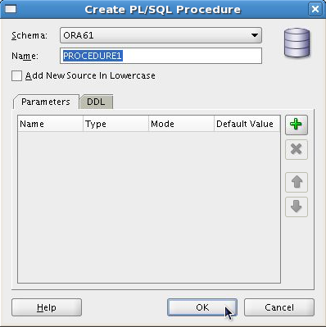
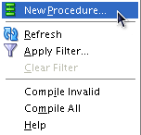
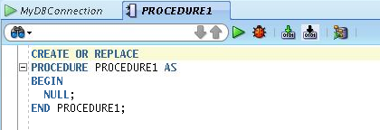
Creating Procedures Using SQL Developer
10-<number>
Notes:
Oracle Database: Develop PL/SQL Program Units 1 - <number>
Creating Procedures Using SQL Developer
1. Right-click the Procedures node on the Connections tabbed page.
2. Select New Procedure from the shortcut menu. The Create PL/SQL Procedure dialog box is displayed. Specify the information for the new procedure, and then click OK to create the subprogram and have it displayed in the Editor window, where you can enter the details.
The components of the Create PL/SQL Procedure dialog box are as follows:
Schema: The database schema in which to create the PL/SQL subprogram
Name: The name of the subprogram that must be unique within a schema
Add New Source in Lowercase: If this option is selected, new text appears in lowercase regardless of the case in which you enter it. This option affects only the appearance of the code, because PL/SQL is not case-sensitive in its execution.
Parameters tab: To add a parameter, click the Add (+) icon. For each parameter in the procedure to be created, specify the parameter name, data type, mode, and optionally the default Value. Use the Remove (X) icon and the arrow icons to delete and to move a parameter up or down in the list respectively.
DDL tab: This tab contains a read-only display of a SQL statement that reflects the current definition of the subprogram.

Slide 15
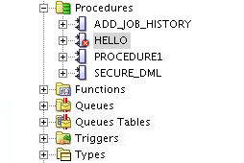
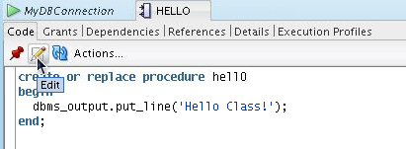
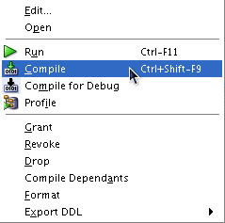
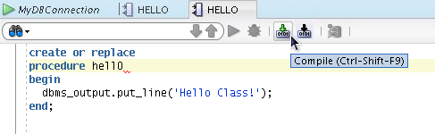
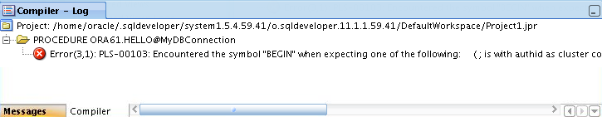
Compiling Procedures and Displaying Compilation Errors in SQL Developer
1
2
OR
10-<number>
Notes:
Oracle Database: Develop PL/SQL Program Units 1 - <number>
Compiling Procedures and Displaying Compilation Errors in SQL Developer
You can compile procedures using one of the following two methods:
Navigate to the Procedures node in the Object Navigator tree. Right-click the procedure’s name, and then select Compile from the shortcut menu. To view any compilation messages, view the Messages subtab in the Compiler – Log tab.
Edit the procedure using the Edit icon on the procedure’s code toolbar. Make the necessary edits, and then click the Compile icon on the code toolbar. To view any compilation messages, view the Messages subtab in the Compiler – Log tab.

Slide 16
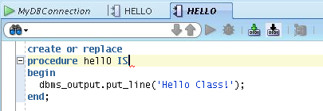

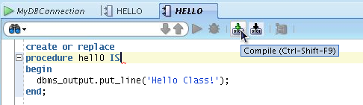

Correcting Compilation Errors in SQL Developer
1. Edit procedure
2. Correct error (add keyword IS)
4. Recompilation successful
3. Recompile procedure
10-<number>
Notes:
Oracle Database: Develop PL/SQL Program Units 1 - <number>
Correcting Compilation Errors in SQL Developer
1. Edit the procedure using the Edit icon on the procedure’s code toolbar. A new procedure code tab is opened in Read/Write mode.
2. Make the necessary corrections.
3. Click the Compile icon on the code toolbar.
4. To view any compilation messages, view the Messages subtab in the Compiler – Log tab. In addition, if the procedure compiled successfully, the red X on the procedure’s name in the Object Navigator tree is removed.

Slide 17
Naming Conventions of PL/SQL Structures Used in This Course
PL/SQL Structure | Convention | Example
Variable | v_variable_name | v_rate
Constant | c_constant_name | c_rate
Subprogram parameter | p_parameter_name | p_id
Bind (host) variable | b_bind_name | b_salary
Cursor | cur_cursor_name | cur_emp
Record | rec_record_name | rec_emp
Type | type_name_type | ename_table_type
Exception | e_exception_name | e_products_invalid
File handle | f_file_handle_name | f_file
10-<number>
Notes:
Oracle Database: Develop PL/SQL Program Units 1 - <number>
Naming Conventions of PL/SQL Structures Used in This Course
The slide table displays some examples of the naming conventions for PL/SQL structures that are used in this course.

Slide 18
What Are Parameters and Parameter Modes?
  Are declared after the subprogram name in the PL/SQL header
  Pass or communicate data between the calling environment and the subprogram
  Are used like local variables but are dependent on their parameter-passing mode:
    An IN parameter mode (the default) provides values for a subprogram to process
    An OUT parameter mode returns a value to the caller
    An IN OUT parameter mode supplies an input value, which may be returned (output) as a modified value
10-<number>
Notes:
Oracle Database: Develop PL/SQL Program Units 1 - <number>
What Are Parameters?
Parameters are used to transfer data values to and from the calling environment and the procedure (or subprogram). Parameters are declared in the subprogram header, after the name and before the declaration section for local variables.
Parameters are subject to one of the three parameter-passing modes: IN, OUT, or IN OUT.
An IN parameter passes a constant value from the calling environment into the procedure.
An OUT parameter passes a value from the procedure to the calling environment.
An IN OUT parameter passes a value from the calling environment to the procedure and a possibly different value from the procedure back to the calling environment using the same parameter.
Parameters can be thought of as a special form of local variable, whose input values are initialized by the calling environment when the subprogram is called, and whose output values are returned to the calling environment when the subprogram returns control to the caller.

Slide 19
Formal and Actual Parameters
  Formal parameters: Local variables declared in the parameter list of a subprogram specification
  Actual parameters (or arguments): Literal values, variables, and expressions used in the parameter list of the calling subprogram
-- Procedure definition, Formal_parameters
CREATE PROCEDURE raise_sal(p_id NUMBER, p_sal NUMBER) IS
BEGIN
. . .
END raise_sal;
-- Procedure calling, Actual parameters (arguments)
v_emp_id := 100;
raise_sal(v_emp_id, 2000)
10-<number>
Notes:
Oracle Database: Develop PL/SQL Program Units 1 - <number>
Formal and Actual Parameters
Formal parameters are local variables that are declared in the parameter list of a subprogram specification. In the first example, in the raise_sal procedure, the variable p_id and
p_ sal identifiers represent the formal parameters.
The actual parameters can be literal values, variables, and expressions that are provided in the parameter list of a calling subprogram. In the second example, a call is made to raise_sal, where the v_emp_id variable provides the actual parameter value for the p_id formal parameter and 2000 is supplied as the actual parameter value for p_sal. Actual parameters:
Are associated with formal parameters during the subprogram call
Can also be expressions, as in the following example:
raise_sal(v_emp_id, raise+100);
The formal and actual parameters should be of compatible data types. If necessary, before assigning the value, PL/SQL converts the data type of the actual parameter value to that of the formal parameter.
Note: Actual parameters are also referred to as actual arguments.

Slide 20
Procedural Parameter Modes
  Parameter modes are specified in the formal parameter declaration, after the parameter name and before its data type.
  The IN mode is the default if no mode is specified.
CREATE PROCEDURE proc_name(param_name [mode] datatype)
...
Modes
Calling
environment
IN (default)
OUT
IN OUT
Procedure
10-<number>
Notes:
Oracle Database: Develop PL/SQL Program Units 1 - <number>
Procedural Parameter Modes
When you create a procedure, the formal parameter defines a variable name whose value is used in the executable section of the PL/SQL block. The actual parameter is used when invoking the procedure to provide input values or receive output results.
The parameter mode IN is the default passing mode—that is, if no mode is specified with a parameter declaration, the parameter is considered to be an IN parameter. The parameter modes OUT and IN OUT must be explicitly specified in their parameter declarations.
The datatype parameter is specified without a size specification. It can be specified:
As an explicit data type
Using the %TYPE definition
Using the %ROWTYPE definition
Note: One or more formal parameters can be declared, each separated by a comma.

Slide 21
Comparing the Parameter Modes
IN
OUT
IN OUT
Default mode
Must be specified
Must be specified
Value is passed into subprogram
Value is returned to the calling environment
Value passed into sub-program; value returned to calling environment
Formal parameter acts as a constant
Uninitialized variable
Initialized variable
Actual parameter can be a literal, expression, constant, or initialized variable
Must be a variable
Must be a variable
Can be assigned a default value
Cannot be assigned
a default value
Cannot be assigned
a default value
10-<number>
Notes:
Oracle Database: Develop PL/SQL Program Units 1 - <number>
Comparing the Parameter Modes
The IN parameter mode is the default mode if no mode is specified in the declaration. The OUT and IN OUT parameter modes must be explicitly specified with the parameter declaration.
A formal parameter of IN mode cannot be assigned a value and cannot be modified in the body of the procedure. By default, the IN parameter is passed by reference. An IN parameter can be assigned a default value in the formal parameter declaration, in which case the caller need not provide a value for the parameter if the default applies.
An OUT or IN OUT parameter must be assigned a value before returning to the calling environment. The OUT and IN OUT parameters cannot be assigned default values. To improve performance with OUT and IN OUT parameters, the NOCOPY compiler hint can be used to request to pass by reference.
Note: Using NOCOPY is discussed later in this course.

Slide 22

Using the IN Parameter Mode: Example
CREATE OR REPLACE PROCEDURE raise_salary
(p_id IN employees.employee_id%TYPE,
p_percent IN NUMBER)
IS
BEGIN
UPDATE employees
SET salary = salary * (1 + p_percent/100)
WHERE employee_id = p_id;
END raise_salary;
/
EXECUTE raise_salary(176, 10)
10-<number>
Notes:
Oracle Database: Develop PL/SQL Program Units 1 - <number>
Using IN Parameters: Example
The example in the slide shows a procedure with two IN parameters. Running the first slide example creates the raise_salary procedure in the database. The second slide example invokes raise_salary and provides the first parameter value of 176 for the employee ID, and a salary increase of 10 percent for the second parameter value.
To invoke a procedure by using the SQL Worksheet of SQL Developer or by using SQL*Plus, use the following EXECUTE command shown in the second code example in the slide.
To invoke a procedure from another procedure, use a direct call inside an executable section of the calling block. At the location of calling the new procedure, enter the procedure name and actual parameters. For example:
...
BEGIN
raise_salary (176, 10);
END;
Note: IN parameters are passed as read-only values from the calling environment into the procedure. Attempts to change the value of an IN parameter result in a compile-time error.

Slide 23
Using the OUT Parameter Mode: Example
CREATE OR REPLACE PROCEDURE query_emp
(p_id IN employees.employee_id%TYPE,
p_name OUT employees.last_name%TYPE,
p_salary OUT employees.salary%TYPE) IS
BEGIN
SELECT last_name, salary INTO p_name, p_salary
FROM employees
WHERE employee_id = p_id;
END query_emp;
/
SET SERVEROUTPUT ON
DECLARE
v_emp_name employees.last_name%TYPE;
v_emp_sal employees.salary%TYPE;
BEGIN
query_emp(171, v_emp_name, v_emp_sal);
DBMS_OUTPUT.PUT_LINE(v_emp_name||' earns '|| to_char(v_emp_sal, '$999,999.00'));
END;
/
10-<number>
Notes:
Oracle Database: Develop PL/SQL Program Units 1 - <number>
Using the OUT Parameters: Example
In the slide example, you create a procedure with OUT parameters to retrieve information about an employee. The procedure accepts the value 171 for employee ID and retrieves the name and salary of the employee with ID 171 into the two OUT parameters. The query_emp procedure has three formal parameters. Two of them are OUT parameters that return values to the calling environment, shown in the second code box in the slide. The procedure accepts an employee ID value through the p_id parameter. The v_emp_name and v_emp_salary variables are populated with the information retrieved from the query into their two corresponding OUT parameters. The following is the result of running the code in the second code example in the slide. v_emp_name holds the value Smith and v_emp_salary holds the value 7400:
Note: Make sure that the data type for the actual parameter variables used to retrieve values from the OUT parameters has a size sufficient to hold the data values being returned.

Slide 24

Using the IN OUT Parameter Mode: Example
Calling environment
p_phone_no (before the call)
p_phone_no (after the call)
'8006330575'
'(800) 633-0575'
CREATE OR REPLACE PROCEDURE format_phone
(p_phone_no IN OUT VARCHAR2) IS
BEGIN
p_phone_no := '(' || SUBSTR(p_phone_no,1,3) ||
') ' || SUBSTR(p_phone_no,4,3) ||
'-' || SUBSTR(p_phone_no,7);
END format_phone;
/
10-<number>
Notes:
Oracle Database: Develop PL/SQL Program Units 1 - <number>
Using IN OUT Parameters: Example
Using an IN OUT parameter, you can pass a value into a procedure that can be updated. The actual parameter value supplied from the calling environment can return either the original unchanged value or a new value that is set within the procedure.
Note: An IN OUT parameter acts as an initialized variable.
The slide example creates a procedure with an IN OUT parameter to accept a 10-character string containing digits for a phone number. The procedure returns the phone number formatted with parentheses around the first three characters and a hyphen after the sixth digit—for example, the phone string 8006330575 is returned as (800) 633-0575.
The following code uses the b_phone_no host variable of SQL*Plus to provide the input value passed to the FORMAT_PHONE procedure. The procedure is executed and returns an updated string in the b_phone_no host variable. The output of the following code is displayed in the slide above:
VARIABLE b_phone_no VARCHAR2(15)
EXECUTE :b_phone_no := '8006330575'
PRINT b_phone_no
EXECUTE format_phone (:b_phone_no)
PRINT b_phone_no

Slide 25

Viewing the OUT Parameters:
Using the DBMS_OUTPUT.PUT_LINE Subroutine
Use PL/SQL variables that are printed with calls to the DBMS_OUTPUT.PUT_LINE procedure.
SET SERVEROUTPUT ON
DECLARE
v_emp_name employees.last_name%TYPE;
v_emp_sal employees.salary%TYPE;
BEGIN
query_emp(171, v_emp_name, v_emp_sal);
DBMS_OUTPUT.PUT_LINE('Name: ' || v_emp_name);
DBMS_OUTPUT.PUT_LINE('Salary: ' || v_emp_sal);
END;
10-<number>
Notes:
Oracle Database: Develop PL/SQL Program Units 1 - <number>
Viewing the OUT Parameters: Using the DBMS_OUTPUT Subroutine
The slide example illustrates how to view the values returned from the OUT parameters in SQL*Plus or the SQL Developer Worksheet.
You can use PL/SQL variables in an anonymous block to retrieve the OUT parameter values. The DBMS_OUPUT.PUT_LINE procedure is called to print the values held in the PL/SQL variables. The SET SERVEROUPUT must be ON.

Slide 26
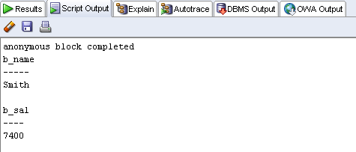
Viewing OUT Parameters:
Using SQL*Plus Host Variables
  1. Use SQL*Plus host variables.
  2. Execute QUERY_EMP using host variables.
  3. Print the host variables.
VARIABLE b_name VARCHAR2(25)
VARIABLE b_sal NUMBER
EXECUTE query_emp(171, :b_name, :b_sal)
PRINT b_name b_sal
10-<number>
Notes:
Oracle Database: Develop PL/SQL Program Units 1 - <number>
Viewing OUT Parameters: Using SQL*Plus Host Variables
The example in the slide demonstrates how to use SQL*Plus host variables that are created using the VARIABLE command. The SQL*Plus variables are external to the PL/SQL block and are known as host or bind variables. To reference host variables from a PL/SQL block, you must prefix their names with a colon (:). To display the values stored in the host variables, you must use the SQL*Plus PRINT command followed by the name of the SQL*Plus variable (without the colon because this is not a PL/SQL command or context).
Note: For details about the VARIABLE command, see the SQL*Plus Command Reference.

Slide 27
Available Notations for Passing Actual Parameters
  When calling a subprogram, you can write the actual parameters using the following notations:
    Positional: Lists the actual parameters in the same order as the formal parameters
    Named: Lists the actual parameters in arbitrary order and uses the association operator (=>) to associate a named formal parameter with its actual parameter
    Mixed: Lists some of the actual parameters as positional and some as named
  Prior to Oracle Database 11g, only the positional notation is supported in calls from SQL
  Starting in Oracle Database 11g, named and mixed notation can be used for specifying arguments in calls to PL/SQL subroutines from SQL statements
10-<number>
Notes:
Oracle Database: Develop PL/SQL Program Units 1 - <number>
Syntax for Passing Parameters
When calling a subprogram, you can write the actual parameters using the following notations:
Positional: You list the actual parameter values in the same order in which the formal parameters are declared. This notation is compact, but if you specify the parameters (especially literals) in the wrong order, the error can be hard to detect. You must change your code if the procedure’s parameter list changes.
Named: You list the actual values in arbitrary order and use the association operator to associate each actual parameter with its formal parameter by name. The PL/SQL association operator is an “equal” sign followed by an “is greater than” sign, without spaces: =>. The order of the parameters is not significant. This notation is more verbose, but makes your code easier to read and maintain. You can sometimes avoid changing your code if the procedure’s parameter list changes, for example, if the parameters are reordered or a new optional parameter is added.
Mixed: You list the first parameter values by their position and the remainder by using the special syntax of the named method. You can use this notation to call procedures that have some required parameters, followed by some optional parameters.

Slide 28
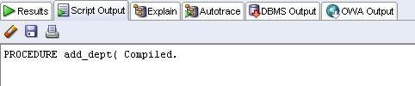
Passing Actual Parameters:
Creating the add_dept Procedure
CREATE OR REPLACE PROCEDURE add_dept(
p_name IN departments.department_name%TYPE,
p_loc IN departments.location_id%TYPE) IS
BEGIN
INSERT INTO departments(department_id,
department_name, location_id)
VALUES (departments_seq.NEXTVAL, p_name , p_loc );
END add_dept;
/
10-<number>
Notes:
Oracle Database: Develop PL/SQL Program Units 1 - <number>
Passing Parameters: Examples
In the slide example, the add_dept procedure declares two IN formal parameters: p_name and p_loc. The values of these parameters are used in the INSERT statement to set the department_name and location_id columns, respectively.

Slide 29
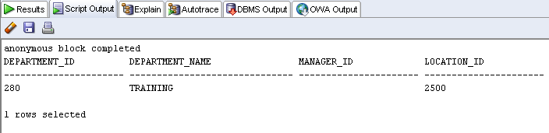

Passing Actual Parameters: Examples
-- Passing parameters using the positional notation.
EXECUTE add_dept ('TRAINING', 2500)
-- Passing parameters using the named notation.
EXECUTE add_dept (p_loc=>2400, p_name=>'EDUCATION')
10-<number>
Notes:
Oracle Database: Develop PL/SQL Program Units 1 - <number>
Passing Actual Parameters: Examples
Passing actual parameters by position is shown in the first call to execute add_dept in the first code example in the slide. The first actual parameter supplies the value TRAINING for the name formal parameter. The second actual parameter value of 2500 is assigned by position to the loc formal parameter.
Passing parameters using the named notation is shown in the second code example in the slide. The loc actual parameter, which is declared as the second formal parameter, is referenced by name in the call, where it is associated with the actual value of 2400. The name parameter is associated with the value EDUCATION. The order of the actual parameters is irrelevant if all parameter values are specified.
Note: You must provide a value for each parameter unless the formal parameter is assigned a default value. Specifying default values for formal parameters is discussed next.

Slide 30
Using the DEFAULT Option for the Parameters
  Defines default values for parameters
  Provides flexibility by combining the positional and named parameter-passing syntax
CREATE OR REPLACE PROCEDURE add_dept(
p_name departments.department_name%TYPE:='Unknown',
p_loc departments.location_id%TYPE DEFAULT 1700)
IS
BEGIN
INSERT INTO departments (department_id, department_name, location_id)
VALUES (departments_seq.NEXTVAL, p_name, p_loc);
END add_dept;
EXECUTE add_dept
EXECUTE add_dept ('ADVERTISING', p_loc => 1200)
EXECUTE add_dept (p_loc => 1200)
10-<number>
Notes:
Oracle Database: Develop PL/SQL Program Units 1 - <number>
Using the DEFAULT Option for Parameters
You can assign a default value to an IN parameter as follows:
The assignment operator (:=), as shown for the name parameter in the slide
The DEFAULT option, as shown for the p_loc parameter in the slide
When default values are assigned to formal parameters, you can call the procedure without supplying an actual parameter value for the parameter. Thus, you can pass different numbers of actual parameters to a subprogram, either by accepting or by overriding the default values as required. It is recommended that you declare parameters without default values first. Then, you can add formal parameters with default values without having to change every call to the procedure.
Note: You cannot assign default values to the OUT and IN OUT parameters.
The second code box in the slide shows three ways of invoking the add_dept procedure:
The first example assigns the default values for each parameter.
The second example illustrates a combination of position and named notation to assign values. In this case, using named notation is presented as an example.
The last example uses the default value for the name parameter, Unknown, and the supplied value for the p_loc parameter.

Slide 31
10-<number>
Notes:
Oracle Database: Develop PL/SQL Program Units 1 - <number>
Using the DEFAULT Option for Parameters (continued)
The following is the result of the second slide code example in the previous slide:
Usually, you can use named notation to override the default values of formal parameters. However, you cannot skip providing an actual parameter if there is no default value provided for a formal parameter.
Note: All the positional parameters should precede the named parameters in a subprogram call. Otherwise, you receive an error message, as shown in the following example:
EXECUTE add_dept(p_name=>'new dept', 'new location')

Slide 32
Calling Procedures
  You can call procedures using anonymous blocks, another procedure, or packages.
  You must own the procedure or have the EXECUTE privilege.
CREATE OR REPLACE PROCEDURE process_employees
IS
CURSOR cur_emp_cursor IS
SELECT employee_id
FROM employees;
BEGIN
FOR emp_rec IN cur_emp_cursor
LOOP
raise_salary(emp_rec.employee_id, 10);
END LOOP;
COMMIT;
END process_employees;
/
10-<number>
Notes:
Oracle Database: Develop PL/SQL Program Units 1 - <number>
Calling Procedures
You can invoke procedures by using:
Anonymous blocks
Another procedure or PL/SQL subprogram
Examples on the preceding pages have illustrated how to use anonymous blocks (or the EXECUTE command in SQL Developer or SQL*Plus).
The example in the slide shows you how to invoke a procedure from another stored procedure. The PROCESS_EMPLOYEES stored procedure uses a cursor to process all the records in the EMPLOYEES table and passes each employee’s ID to the RAISE_SALARY procedure, which results in a 10% salary increase across the company.
Note: You must own the procedure or have the EXECUTE privilege.

Slide 33
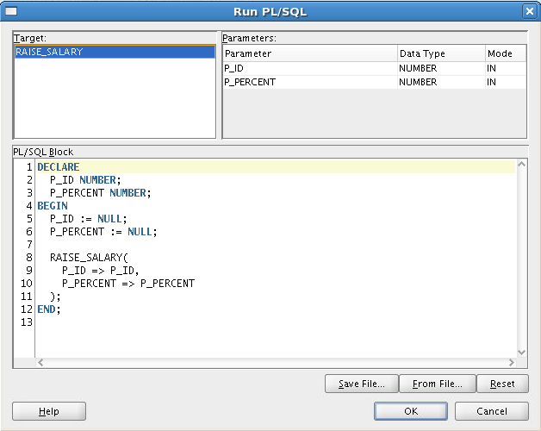
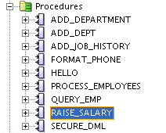
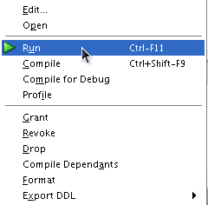
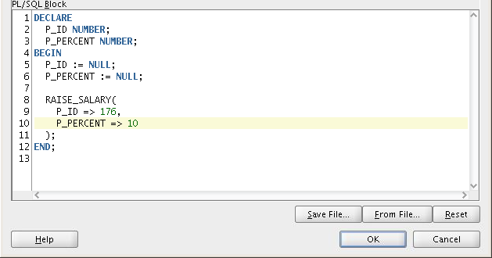
Calling Procedures Using SQL Developer
1
Replace P_ID and P_PERCENT
with actual values
2
3
4
10-<number>
Notes:
Oracle Database: Develop PL/SQL Program Units 1 - <number>
Calling Procedures Using SQL Developer
In the slide example, the raise_salary procedure is called to raise the current salary of employee 176 ($ 8,600) by 10 percent as follows:
1. Right-click the procedure name in the Procedures node, and then click Run. The Run PL/SQL dialog box is displayed.
2. In the PL/SQL Block section, change the displayed formal IN and IN/OUT parameter specifications displayed after the association operator, “=>” to the actual values that you want to use for running or debugging the function or procedure. For example, to raise the current salary of employee 176 from 8,600 by 10 percent, you can call the raise_salary procedure as shown in the slide. Provide the values for the ID and PERCENT input parameters that are specified as 176 and 10 respectively. This is done by changing the displayed ID => ID with ID => 176 and PERCENT => PERCENT with PERCENT => 10.
3. Click OK. SQL Developer runs the procedure. The updated salary of 9,460 is shown below:

Slide 34
Session Plan
Using a modularized and layered subprogram design and identifying the benefits of subprograms
Subprogram Design
    Creating and calling procedures
    Identifying the available parameter-passing modes
    Using formal and actual parameters
    Using positional, named, or mixed notation
Procedures
Exception Handling
Handling exceptions in procedures, removing a procedure, and displaying the procedures’ information
10-<number>
Notes:
Oracle Database: Develop PL/SQL Program Units 1 - <number>

Slide 35
Handled Exceptions
Calling procedure
Called procedure
PROCEDURE
PROC1 ...
IS
...
BEGIN
...
PROC2(arg1);
...
EXCEPTION
...
END PROC1;
PROCEDURE
PROC2 ...
IS
...
BEGIN
...
EXCEPTION
...
END PROC2;
Exception raised
Exception handled
Control returns
to calling procedure
10-<number>
Notes:
Oracle Database: Develop PL/SQL Program Units 1 - <number>
Handled Exceptions
When you develop procedures that are called from other procedures, you should be aware of the effects that handled and unhandled exceptions have on the transaction and the calling procedure.
When an exception is raised in a called procedure, the control immediately goes to the exception section of that block. An exception is considered handled if the exception section provides a handler for the exception raised.
When an exception occurs and is handled, the following code flow takes place:
1. The exception is raised.
2. Control is transferred to the exception handler.
3. The block is terminated.
4. The calling program/block continues to execute as if nothing has happened.
If a transaction was started (that is, if any data manipulation language [DML] statements executed before executing the procedure in which the exception was raised), then the transaction is unaffected. A DML operation is rolled back if it was performed within the procedure before the exception.
Note: You can explicitly end a transaction by executing a COMMIT or ROLLBACK operation in the exception section.

Slide 36


Handled Exceptions: Example
CREATE PROCEDURE add_department(
p_name VARCHAR2, p_mgr NUMBER, p_loc NUMBER) IS
BEGIN
INSERT INTO DEPARTMENTS (department_id,
department_name, manager_id, location_id)
VALUES (DEPARTMENTS_SEQ.NEXTVAL, p_name, p_mgr, p_loc);
DBMS_OUTPUT.PUT_LINE('Added Dept: '|| p_name);
EXCEPTION
WHEN OTHERS THEN
DBMS_OUTPUT.PUT_LINE('Err: adding dept: '|| p_name);
END;
CREATE PROCEDURE create_departments IS
BEGIN
add_department('Media', 100, 1800);
add_department('Editing', 99, 1800);
add_department('Advertising', 101, 1800);
END;
10-<number>
Notes:
Oracle Database: Develop PL/SQL Program Units 1 - <number>
Handled Exceptions: Example
The two procedures in the slide are the following:
The add_department procedure creates a new department record by allocating a new department number from an Oracle sequence, and sets the department_name, manager_id, and location_id column values using the p_name, p_mgr, and p_loc parameters, respectively.
The create_departments procedure creates more than one department by using calls to the add_department procedure.
The add_department procedure catches all raised exceptions in its own handler. When create_departments is executed, the following output is generated:
The Editing department with a manager_id of 99 is not inserted because a foreign key integrity constraint violation on manager_id ensures that no manager has an ID of 99. Because the exception was handled in the add_department procedure, the create_department procedure continues to execute. A query on the DEPARTMENTS table where the location_id is 1800 shows that Media and Advertising are added but the Editing record is not.

Slide 37
Exceptions Not Handled
Calling procedure
Called procedure
PROCEDURE
PROC1 ...
IS
...
BEGIN
...
PROC2(arg1);
...
EXCEPTION
...
END PROC1;
PROCEDURE
PROC2 ...
IS
...
BEGIN
...
EXCEPTION
...
END PROC2;
Exception raised
Exception not handled
Control returned
to exception section of calling procedure
10-<number>
Notes:
Oracle Database: Develop PL/SQL Program Units 1 - <number>
Exceptions Not Handled
As discussed earlier, when an exception is raised in a called procedure, control immediately goes to the exception section of that block. If the exception section does not provide a handler for the raised exception, then it is not handled. The following code flow occurs:
1. The exception is raised.
2. The block terminates because no exception handler exists; any DML operations performed within the procedure are rolled back.
3. The exception propagates to the exception section of the calling procedure—that is, control is returned to the exception section of the calling block, if one exists.
If an exception is not handled, then all the DML statements in the calling procedure and the called procedure are rolled back along with any changes to any host variables. The DML statements that are not affected are statements that were executed before calling the PL/SQL code whose exceptions are not handled.

Slide 38
Exceptions Not Handled: Example
SET SERVEROUTPUT ON
CREATE PROCEDURE add_department_noex(
p_name VARCHAR2, p_mgr NUMBER, p_loc NUMBER) IS
BEGIN
INSERT INTO DEPARTMENTS (department_id,
department_name, manager_id, location_id)
VALUES (DEPARTMENTS_SEQ.NEXTVAL, p_name, p_mgr, p_loc);
DBMS_OUTPUT.PUT_LINE('Added Dept: '|| p_name);
END;
CREATE PROCEDURE create_departments_noex IS
BEGIN
add_department_noex('Media', 100, 1800);
add_department_noex('Editing', 99, 1800);
add_department_noex('Advertising', 101, 1800);
END;
10-<number>
Notes:
Oracle Database: Develop PL/SQL Program Units 1 - <number>
Exceptions Not Handled: Example
The code example in the slide shows add_department_noex, which does not have an exception section. In this case, the exception occurs when the Editing department is added. Because of the lack of exception handling in either of the subprograms, no new department records are added into the DEPARTMENTS table. Executing the create_departments_noex procedure produces a result that is similar to the following:
Although the results show that the Media department was added, its operation is rolled back because the exception was not handled in either of the subprograms invoked.

Slide 39
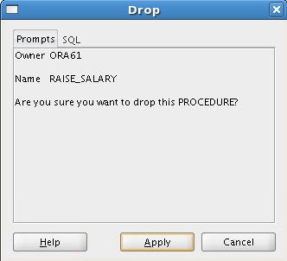
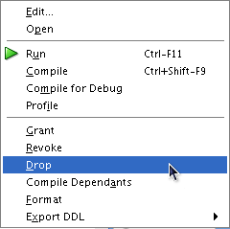
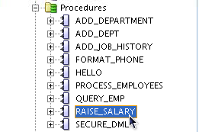
Removing Procedures:
Using the DROP
  Using the DROP statement:
DROP PROCEDURE raise_salary;
-Using SQL Developer
2
1
3
10-<number>
Notes:
Oracle Database: Develop PL/SQL Program Units 1 - <number>
Removing Procedures: Using the DROP SQL Statement or SQL Developer
When a stored procedure is no longer required, you can use the DROP PROCEDURE SQL statement followed by the procedure’s name to remove it as follows:
DROP PROCEDURE procedure_name
You can also use SQL Developer to drop a stored procedure as follows:
1. Right-click the procedure name in the Procedures node, and then click Drop. The Drop dialog box is displayed.
2. Click Apply to drop the procedure.
Note
Whether successful or not, executing a data definition language (DDL) command such as DROP PROCEDURE commits any pending transactions that cannot be rolled back.
You might have to refresh the Procedures node before you can see the results of the drop operation. To refresh the Procedures node, right-click the procedure name in the Procedures node, and then click Refresh.

Slide 40
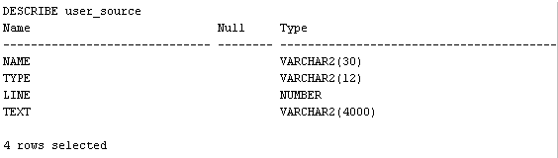
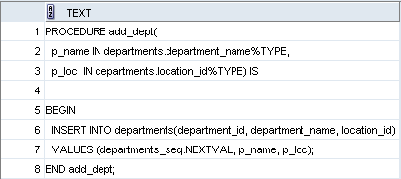
Viewing Procedure Information
Using the Data Dictionary Views
DESCRIBE user_source
SELECT text
FROM user_source
WHERE name = 'ADD_DEPT' AND type = 'PROCEDURE'
ORDER BY line;
10-<number>
Notes:
Oracle Database: Develop PL/SQL Program Units 1 - <number>
Viewing Procedure in the Data Dictionary
The source code for PL/SQL subprograms is stored in the data dictionary tables. The source code is accessible to PL/SQL procedures that are successfully or unsuccessfully compiled. To view the PL/SQL source code stored in the data dictionary, execute a SELECT statement on the following tables:
The USER_SOURCE table to display PL/SQL code that you own
The ALL_SOURCE table to display PL/SQL code to which you have been granted the EXECUTE right by the owner of that subprogram code
The query example shows all the columns provided by the USER_SOURCE table:
The TEXT column holds a line of PL/SQL source code.
The NAME column holds the name of the subprogram in uppercase text.
The TYPE column holds the subprogram type, such as PROCEDURE or FUNCTION.
The LINE column stores the line number for each source code line.
The ALL_SOURCE table provides an OWNER column in addition to the preceding columns.
Note: You cannot display the source code for Oracle PL/SQL built-in packages, or PL/SQL whose source code has been wrapped by using a WRAP utility. The WRAP utility converts the PL/SQL source code into a form that cannot be deciphered by humans.

Slide 41
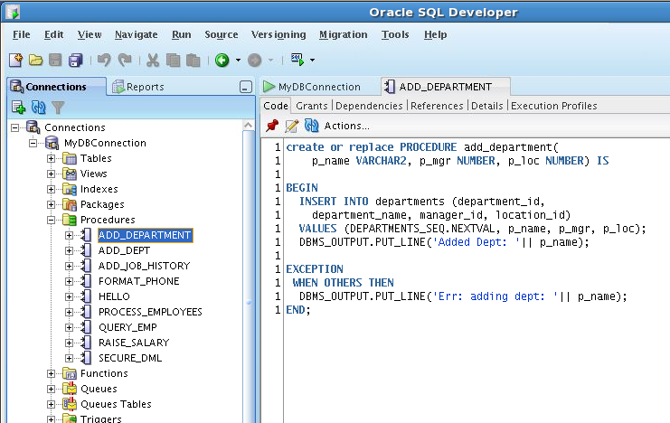
Viewing Procedures Information
Using the SQL Developer
3
1
2
10-<number>
Notes:
Oracle Database: Develop PL/SQL Program Units 1 - <number>
Viewing Procedures Information Using SQL Developer
To view a procedure’s code in SQL Developer, use the following steps:
1. Click the Procedures node in the Connections tab.
2. Click the procedure’s name.
3. The procedure's code is displayed in the Code tab as shown in the slide.

Slide 42
Quiz
Formal parameters are literal values, variables, and expressions used in the parameter list of the calling subprogram
  True
  False
10-<number>
Notes:
Oracle Database: Develop PL/SQL Program Units 1 - <number>
Answer: 2
Formal and Actual (or arguments) Parameters
Formal parameters: Local variables declared in the parameter list of a subprogram specification.
Actual parameters: Literal values, variables, and expressions used in the parameter list of the calling subprogram.

